Slide 1
SportsPlex Sprint 3
Presented By: Edward Marks, Peter Kowalski, Matt Degraeve, Anthony Saleh, Graydon Peck, Colin Neil

Slide 2
Sprint 2 Goals
Create initial framework of system and main objects
Design Database Architecture

Slide 3
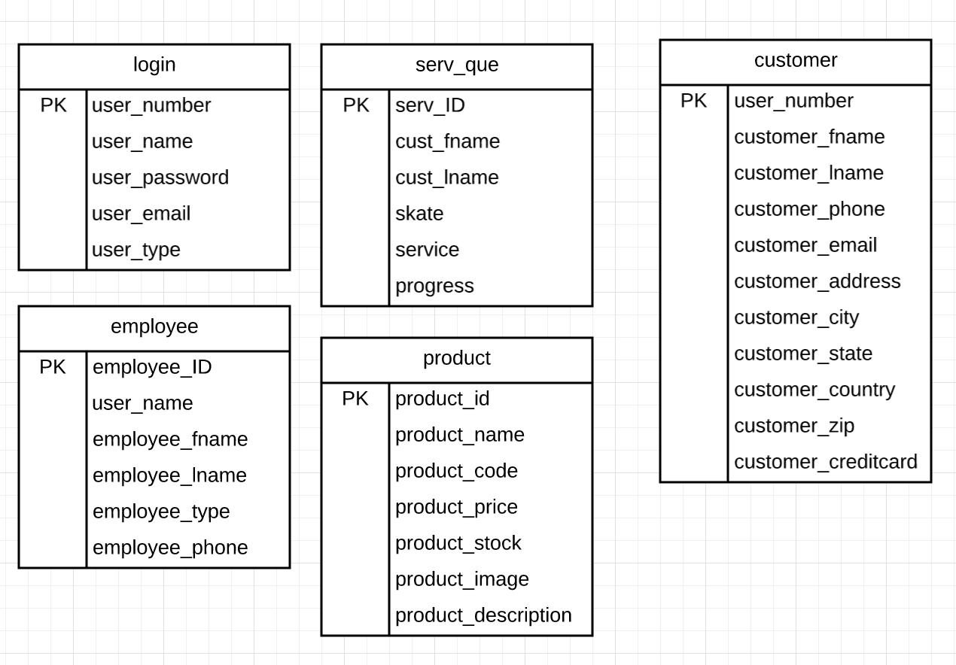
Entity Relationship Diagram

Slide 4
Risk Analysis
Risk | Likelihood | Impact | Priority | Mitigation Plan
Members creating objects that don’t match system styling | 10 | 4 | 3 | Collaborate when creating new objects to agree upon styling
Duplicate item creation | 8 | 6 | 2 | Communication with group on what items you are working on
Poor database design | 6 | 10 | 1 | Appropriate time spent modeling database

Slide 5
Next Sprint Goals
Create service Center System
Create systems/page for employee functionality

Slide 6
Main Use Cases

Slide 7
A Manager can create an employee account
Initiating Actor(s):
Manager
Employee
Actor’s Goal:
To register for an Employee the person doing that has to have admin rights as a Manager
Preconditions:
The employee is not already registered
The manager has admin rights
Postconditions:
The employee is sent to the employee page once verified

Slide 8
Flow of Events for Main Success Scenario:
● Manager press button to add employee (Trigger Action)
● System prompts the manager for a username of employee
● Actor Supplies a valid username
● System prompts the user for a password
● Actor supplies a valid password
● System checks for unique username and password to see if they are already taken/valid
● Saves user credentials to the database if they are valid
● Manager presses the “Submit” Button to Confirm
● System sends a confirmation message that account was created
Exceptions
No Internet Connection
Error Connecting to the database
Account Already Exist

Slide 9
A manager can assign employees to work stations
Initiating Actor(s):
Manager
Employee
Actor’s Goal:
Add the employee to a given work station the time they are working
Preconditions:
The employee must have an account
Postconditions:
The employee is assigned to that workstation.

Slide 10
Flow of Events for Main Success Scenario:
Manager clicks on button to assign an employee to a workstation (Trigger Action)
Manager selects an empty work station
System checks to make sure that the workstation is empty
Manager adds an employee to that work station that is not already assigned to one
System checks to make sure that employee is not assigned to a work station
System will add that employee to the workstation
Exceptions
No Internet Connection
Error Connecting to the database
Work station already assigned
Employee is assigned to a different workstation

Slide 11
Employees and Managers can add or remove customers to service queue
Initiating Actor(s):
Manager
Employee
Actor’s Goal:
Employees and managers can add or remove things on the service queue
Preconditions:
The employee/manager must have an account
Postconditions:
Customers will be added or removed off of the service queue

Slide 12
Flow of Events for Main Success Scenario:
Employee or Manager will add customer into service queue (Trigger Action)
The system will make sure all of the customer information is filled out correctly
The system will make sure that the customer is not already added
Once the customer is done the employee or manager will remove the customer from the queue.
Exceptions
No Internet Connection
Error Connecting to the database
Employee or Manager not putting correct information about the customer in the database

Slide 13
END

